Slide 1
Fractals!
Fractals are these crazy objects which stretch our understanding of shape and space, moving into the weird world of infinity. We will look at examples of fractals such as the Koch snowflake and the Sierpinski's triangle. We will talk about making fractals, and think about the various dimensions of a fractal. Does it make sense to talk about its dimensions? Can we call it a 2-dimensional or a 3-dimensional object? Look forward to stretching your imagination and playing with mathematics!
Notes:
Total Notes:
Fractals Title Slide
Various Fractal Images
What is a fractal – self-similarity, and continuous but nowhere differentiable. How do we build a fractal? (Slides 1-3, about 5 – 10 minutes)
Constructing the Koch Curve and the Sierpinski’s Triangle. Questions to consider: Compute area under Koch Curve, discuss area of Sierpinski’s Triangle.
Various other ways to construct Sierpinski Triangle – Cutting Triangles, Pascal’s Triangle, Chaos Game. In your groups, come up with your own fractals; can you find more ways to come up with your fractal? – if some groups finish early, have them start to think about dimension. (Slides 4-5, about 5-10 minutes) (Group work 10 minutes)
Dimension: Does a fractal have a dimension? What does dimension even mean? Hausdorff – “amount of space”; Minkowski-Bouligand (box-counting) – size compared to length.
Box-Counting Dimension image. Try to figure out the dimensions for the Koch Curve and Sierpinski’s Triangle. Can they compute the dimension of the fractals that they created? (Slides 6-7, about 5 – 10 minutes; w/out their group work) (Group work 10 minutes)
Statement of dimensions for the Koch Curve and Sierpinski’s Triangle.

Slide 2
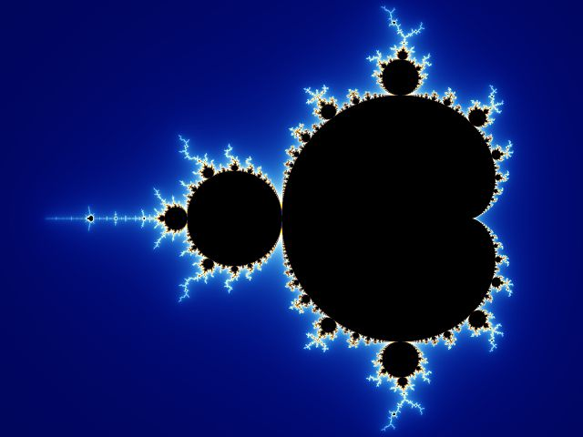
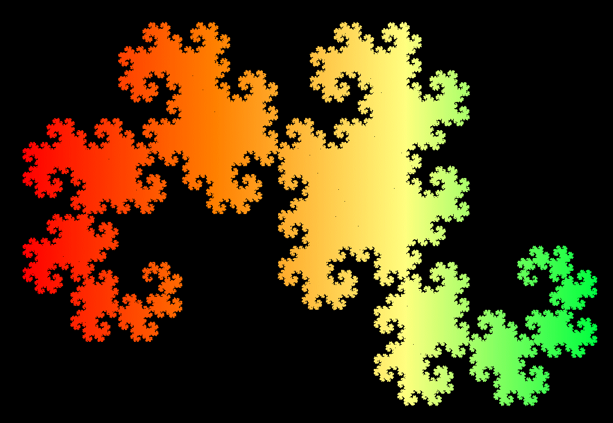
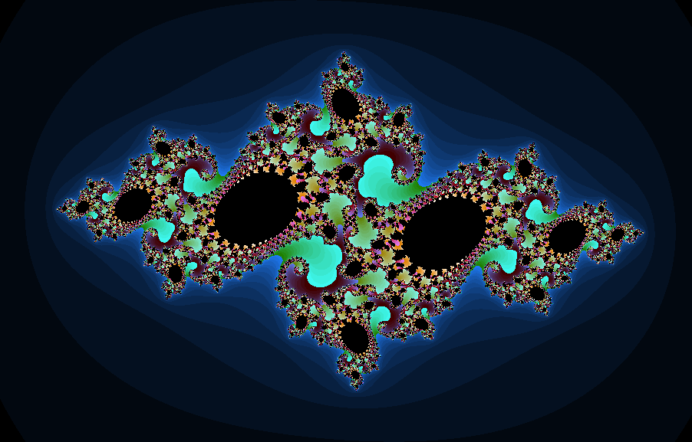
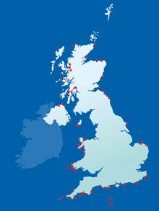
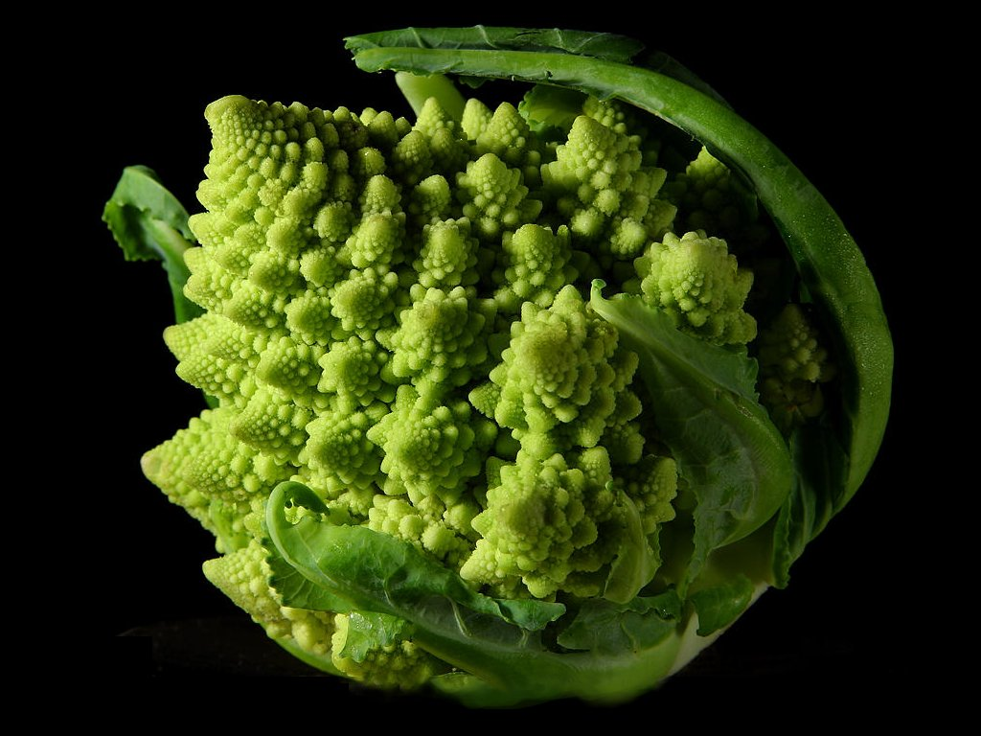

Slide 3
So, how do we build a fractal?
Self-Similarity
  Things look the “same” when you zoom in anywhere by any amount in a “non-trivial” way.
Continuous, but nowhere differentiable
  Everything is connected, but it’s “pointy” everywhere.
What is a fractal?
Some kind of infinitely repeating rule
Some kind of rule which creates “pointy” things

Slide 4
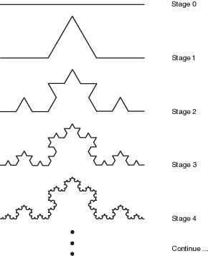
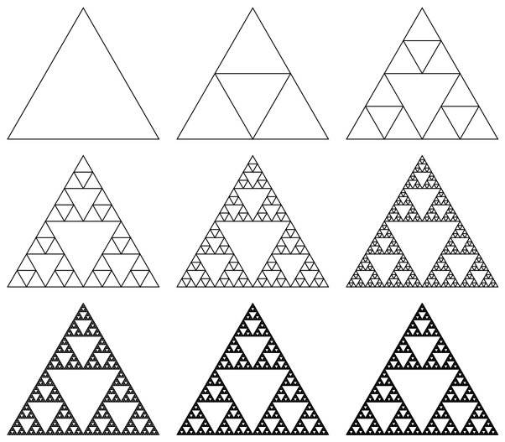
Koch Curve
Sierpinski’s Triangle
Notes:
Questions to consider: Computing area under the Koch curve; talk about how much 2-dim “space” the triangle takes up – does it have area?

Slide 5
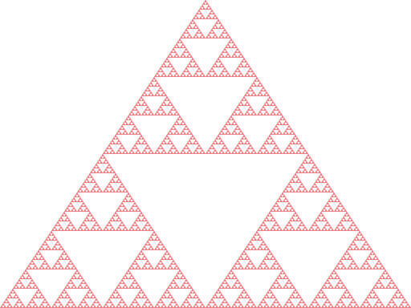
Constructing the Sierpinski’s Triangle
Cutting out triangles!
Pascal’s triangle!
Chaos game!
Notes:
In your groups, see if you can come up with your own fractals; are there more ways to construct your fractal? If some groups finish early, ask them about dimension?

Slide 6
What does dimension even mean?
Does a fractal have dimension?
Examples of dimension measures:
Hausdorff dimension – how much “space” things take up.
Minkowski-Bouligand dimension (box-counting dimension) – “size” compared to length.

Slide 7
Box-Counting Dimension
1
2
4
1
1
2
1
2

Slide 8
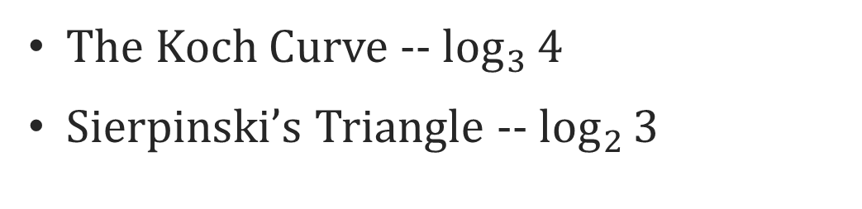
Fractal Dimensions
The Koch Curve -- $\log_{3}{4}$
Sierpinski’s Triangle -- $\log_{2}{3}$

